Slide 1
Amazon VPC

Slide 2
Amazon VPC
A virtual private cloud (VPC) is a virtual network dedicated to your AWS account
It is logically isolated from other virtual networks in the AWS cloud
CIDR Range 10.0.0.0/16

Slide 3
VPC Components
Subnets
IP Addressing
Route Tables
Internet Gateways
Security Group
Network ACLs
NAT Instances

Slide 4
Subnets
Private Subnet
The subnet that is not associated with a route table having Internet Gateway as one of the rule
Public Subnet
The Subnet that is associated with a route table having Internet Gateway as one of the rule

Slide 5
IP Addressing
Private IP Address
Public IP Address
Elastic IP Address

Slide 6
Route Tables
A route table contains a set of rules, called routes, that are used to determine where network traffic is directed.
One route table per subnet
Main route table and custom route table

Slide 7
Internet Gateways
Internet Gateways are used to enable internet access to the instances in the VPC environment
One Internet Gateway per VPC

Slide 8
Security Groups
A Firewall layer for the EC2 instance to which the security group is attached.
Stateful

Slide 9
Network Access Control List
A Firewall layer for the subnets to which the Network ACL is attached
Stateless

Slide 10
NAT Instances
NAT instances are used to enable internet access for the instances in the private subnet of the VPC
NAT Security Group

Slide 11
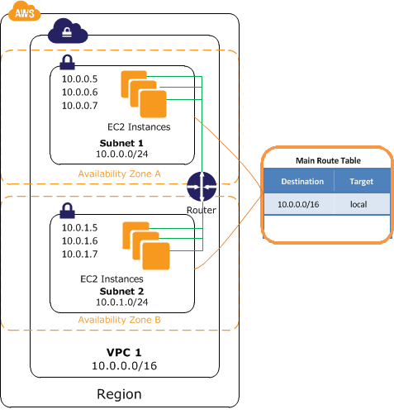
Example1-Without Internet Access

Slide 12
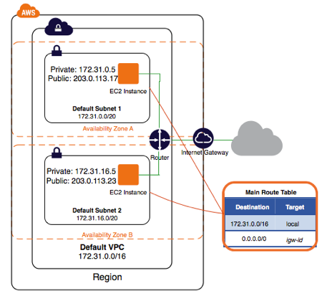
Example2-With Internet Access

Slide 13
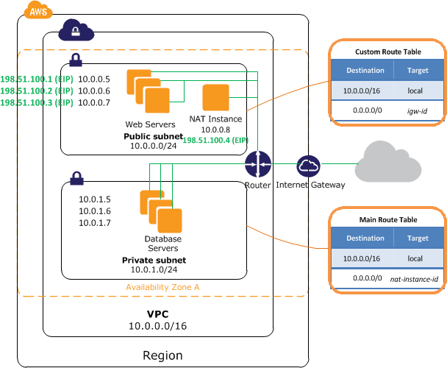
Example3- Private Subnet With Internet Access

Slide 14

Thank You

